Slide 1
Presentation title
Add a brief explanation of the presentation’s purpose

Slide 3



Cloud native WAL Storage
Postgres With High Availability (4 hops)
Azure HorizonDB with WAL Service (single hop)
Zone 1
Zone 2
Zone 3
2. WAL Send
4. Ack
1.
WAL
Write
3.
WAL
Write
Majority Quorum
Write
Wal Send
WAL Storage fleet

Slide 4


Purpose built WAL Storage
Postgres Compute
Optimized for:
Append-only writes
Low and predictable write latency
Reads most often near the tail
WAL archived to blob storage
Quorum Manager
io_uring
WAL Writer
Async io_uring runtime
NVME
Passthrough
WAL Storage Node
Rust Async runtime: aka.ms/kimojio
WAL Archive
Azure Blob Storage

Slide 5
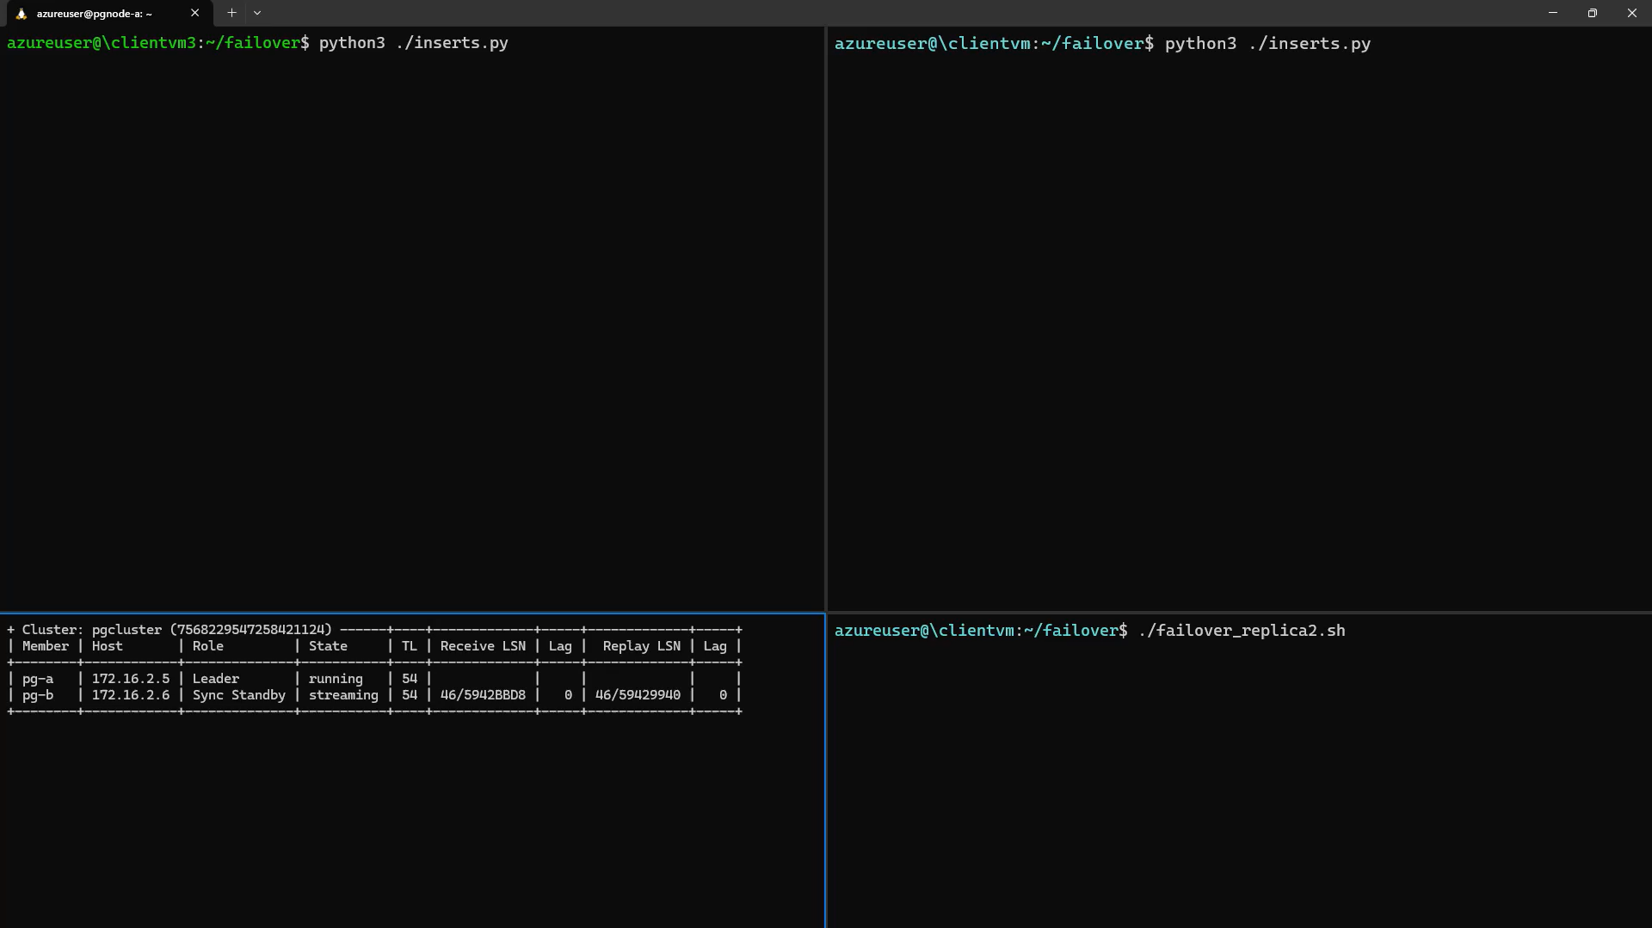
Demo (6)

Slide 6




Announcing at Ignite 2025
What’s new
Performance
Analytics
Security & compliance
Migration/Dev
Azure HorizonDB (Private preview)
New Intel and AMD v6-series SKUs (Preview)
Scale to multiple nodes with Elastic Clusters (GA)
PostgreSQL 18 (GA)
Realtime analytics with Fabric Mirroring (GA)
azure_storage extension Parquet support (GA)
Analytical queries inside PostgreSQL with the pg_duckdb extension (Preview)
Meet compliance requirements with the credcheck, anon & ip4r extensions (GA)
Integrated identity with Entra token-refresh libraries for Python (GA)
AI-Assisted Oracle to PostgreSQL Migration Tool (Preview)
PostgreSQL extension for VS Code (GA)
Microsoft Foundry PostgreSQL integration
aka.ms/ignite-25-pgsql

Slide 7
The migration: lessons learnt & best practices
Scope | Parameters | Configurations | Best Practice
Capacity Setup | Shared Buffers | Up to 45% to Total RAM | Iterate it with gradual configuration to arrive at best optimum config
 | Effective_Cache_Size | Up to 75% of Total RAM
 | Work_memory | Default values
Performance Optimization | Connection Pooling | Pgbouncer with transaction pooling mode | To manage effective and efficient connections pgbouncer.pool_mode = Transaction pgbouncer.default_pool_size = 192 (Tested with 64vCpu & 96vCPU server)
 | Autovacuum | Pg_catalog schema | Regular monitoring to avoid performance degradation
 | Intelligent Tuning | ON
 | Temp tablespaces on SSD | ON
 | Idle transaction session timeout | 300000
DR & BCP | Cross Subscription Replication | ON
Master Data Management | Logical Replication |  | Logical Replications to manage Oracle-MViews

Slide 8



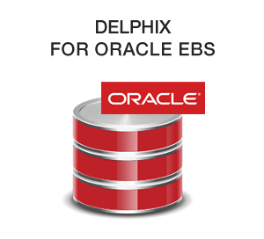




Architecture overview
Schema conversion
Azure Subscription
Live Postgres for Compile Testing
Other Cloud Environment
gpt-4.1
Azure PostgreSQL Database
Oracle Database (Any location accessible from VS Code Client)
Oracle Database (Any location accessible from VS Code Client)
3
Azure OpenAI
4
On-Prem Local Desktop
1
VS Code
VS Code Extension for PostreSQL
On-Prem Environment
Developer / DBA / Database Architect
Oracle Connectivity
DDL Extraction
Multi-Agent Workflow
Dependency Management
Smart Chunking
Task Management
GitHub Copilot Agent Mode for Task Completion
Oracle Database (Any location accessible from VS Code Client)
5
2
VS Code GitHub Copilot Agent Mode

Slide 9



A closer look Schema migration AI architecture
Oracle DDL Objects Extracted
Dependency Graph Generated
The Schema Conversion module is built using a multi-agent orchestration.
During the Migration Specialist, a Postgres Compile Tool is used to validate the converted chunk.
1
2
3
4
Chunks created
Process 1 or more chunks at a time
Migration Specialist Agent
Agent Tools:
Postgres Test Compile Tool
Query Database Tool
Query Columns Tool
Etc…
Test Compile Chunk and Validate
Azure PostgreSQL Database
Migration Critic Agent
AutoGen Multi-Agent “Swarm”
Documentation Agent

Slide 10



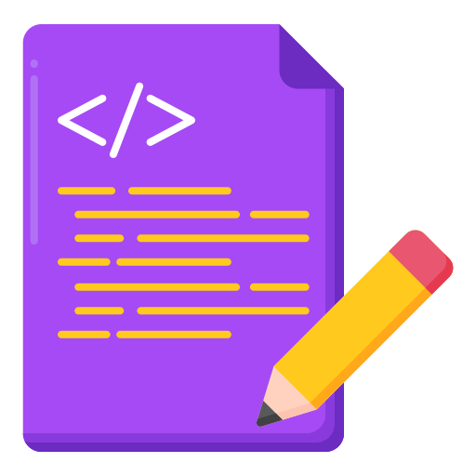
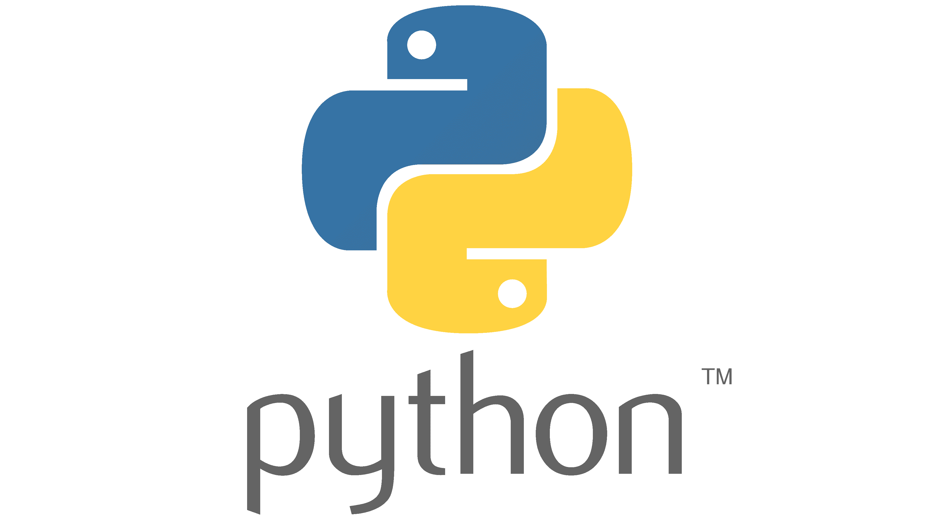



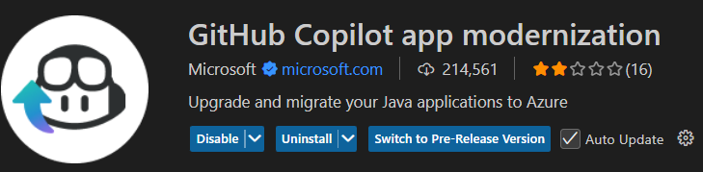



A closer look
Application migration AI architecture
“Coding Notes” context brought in from schema conversion stage.
Agent Mode Application Conversion Tool
VS Code GitHub Copilot Agent Mode
PostgreSQL Language Model Tools
1
Claude Sonnet 4 or 4.5
Validate code conversion against true, converted version of database schema.
Postgres Database Connection
Postgres Database Query
Etc…
2
Azure PostgreSQL Database
2-way integration. If GitHub Copilot App Mod Extensions are installed, and converting Java code, additional tools are automatically used for additional capabilities.
App Mod Language Model Tools
(Via Copilot App Mod Extension)
Build Java Project
Generate Java Unit Tests
Converted Application Code to Postgres Context
Detailed report on Application Code Conversion results

Slide 12
Announcing
New Foundry models Anthropic's Claude Models (Sonnet, Opus and Haiku) GPT-5.1 series Coming soon: Cohere Command A, Embed 4 and Rerank 3.5 Black Forest Labs FLUX.2 |  | Reasoning-drive, multimodal and coding-ready AI solutions
Model router in Foundry Models |  | Choose the right LLM for your diverse use cases
Priority Processing |  | Guaranteed Low latency with no commitment
Provisioned throughput Dynamic Spillover |  | Manage traffic bursts without service disruption
Prompt Caching |  | Accelerates response times, scales throughput, and cuts token cost
Public Preview
General Availability
Public Preview
General Availability
General Availability

Slide 13







Service Groups
Service Groups
Tenant
Root MG
Root SG
Division
Product Line
Sub-Department
Application
Service
Comp
Comp
Comp
Instance

Slide 14

Scope Selection
 | Management Groups | Subscriptions | Resource Groups | Tags | Service Groups
Azure Policy and RBAC inheritance
Dynamic membership
Limit control to subset of users

